Slide 1
DESIGN OF AUGMENTED REALITY AND VIRTUAL REALITY
- ROHAN N KALPAVRUKSHA
ROSHAN N KALPAVRUKSHA

Slide 2
VIRTUAL REALITY
VR in Military
The military in the UK and the US have both adopted the use of virtual reality in their training as it allows them to undertake a huge range of simulations. VR is used in all branches of service: the army, navy, air force, marines and coast guard.
2. VR in Sport
VR is revolutionising the sports industry for players, coaches and viewers. Virtual reality can be used by coaches and players to train more efficiently across a range of sports, as they are able to watch and experience certain situations repeatedly and can improve each time.
3. VR in Mental Health
As mentioned briefly before, VR technology has become a primary method for treating post-traumatic stress. Using VR exposure therapy, a person enters a re-enactment of a traumatic event in an attempt to come to terms with the event and heal.

Slide 3
4. VR in Medical Training
Due to its interactive nature, medical and dental students have begun using VR to practice surgeries and procedures, allowing for a consequence free learning environment;
5. VR in Education
VR uses for education don’t stop at the military or medical field, but extend to schools with virtual reality also adopted in education for teaching and learning situations.
6. VR in Fashion
A lesser known use of VR is in fashion where it has actually been having quite a profound impact. For example, virtual simulations of store environments can be extremely useful for retailers to design their signage and product displays without fully committing to the build like you would in the real world.

Slide 4
VR
Mobile VR - As suggested by its name is defined by the portability factor. The first generation of mobile VR headsets often used a smartphone that you would put into the headset shell. The current generation mobile VR headsets use standalone hardware and mobile processors integrated into the headset itself.
Desktop VR - Desktop VR is sometimes called the Full VR because it allows for a more full VR experience and includes features such as positional tracking for the head and both hand controllers. A variety of desktop VR systems exist with some featuring additional add-ons such as omnidirectional treadmills, full room trackers, gloves, interfaces for multiple different controllers, etc.

Slide 5
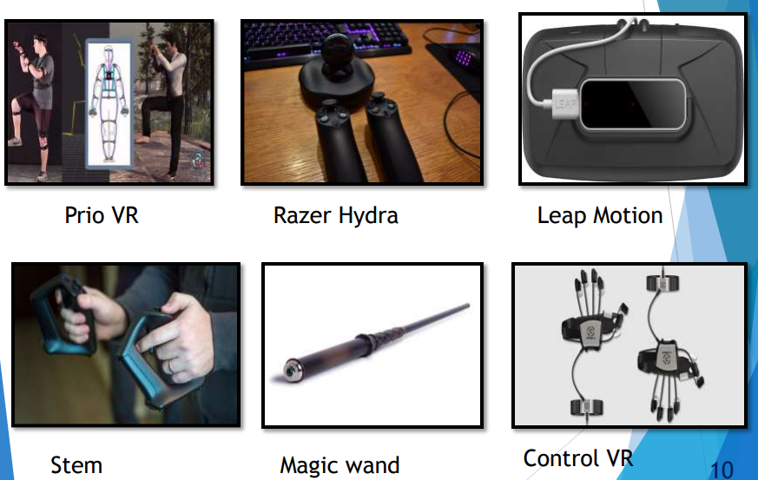
HARDWARE DEVICE
INPUT DEVICES

Slide 6
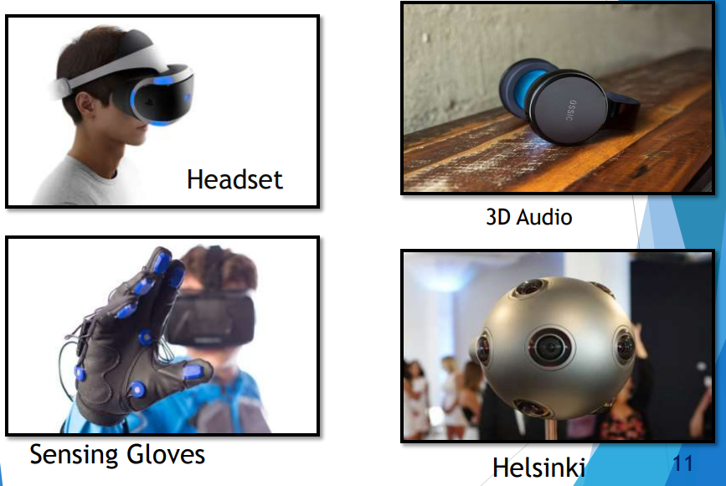
OUTPUT DEVICES

Slide 7
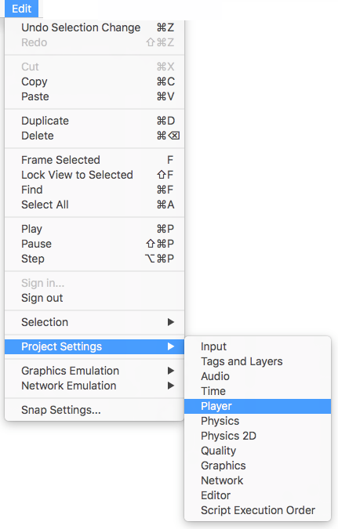
STEPS TO VR
ENABLE VR SUPPORT
To enable VR for your game builds and the editor, open the Player Settings (menu: Edit > Project Settings > Player). Select Other Settings and check the Virtual Reality Supported checkbox. Set this for each build target. Enabling virtual reality support in a standalone build will not also enable the support for Android (or vice versa).

Slide 8
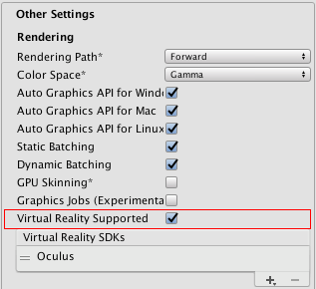

Use the Virtual Reality SDK list displayed below the checkbox to add and remove Virtual Reality Devices for each build target. The order of the list is the order that Unity will try to enable VR Devices at runtime. The first device that initializes properly will be the one enabled. This list order will be the same in the built player.
The camera transform is overridden with the head-tracked pose. To move or rotate the camera, attach it as a child of another GameObject. This makes it so that all transform changes to the parent of the camera will affect the camera itself. This also applies to moving or rotating the camera using a script.

Slide 9
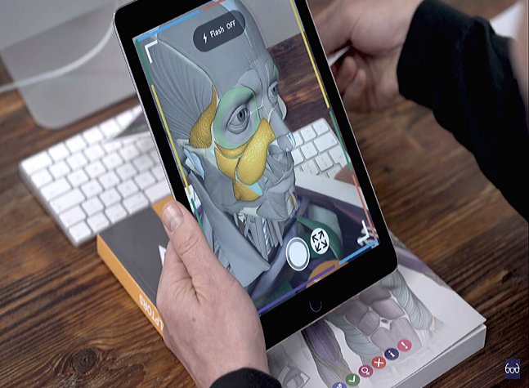
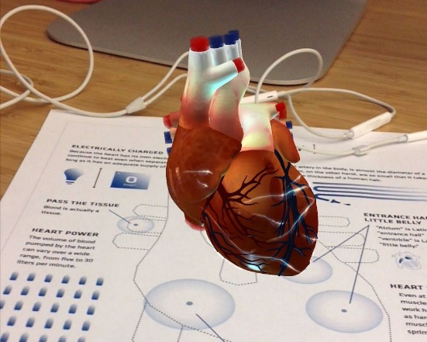
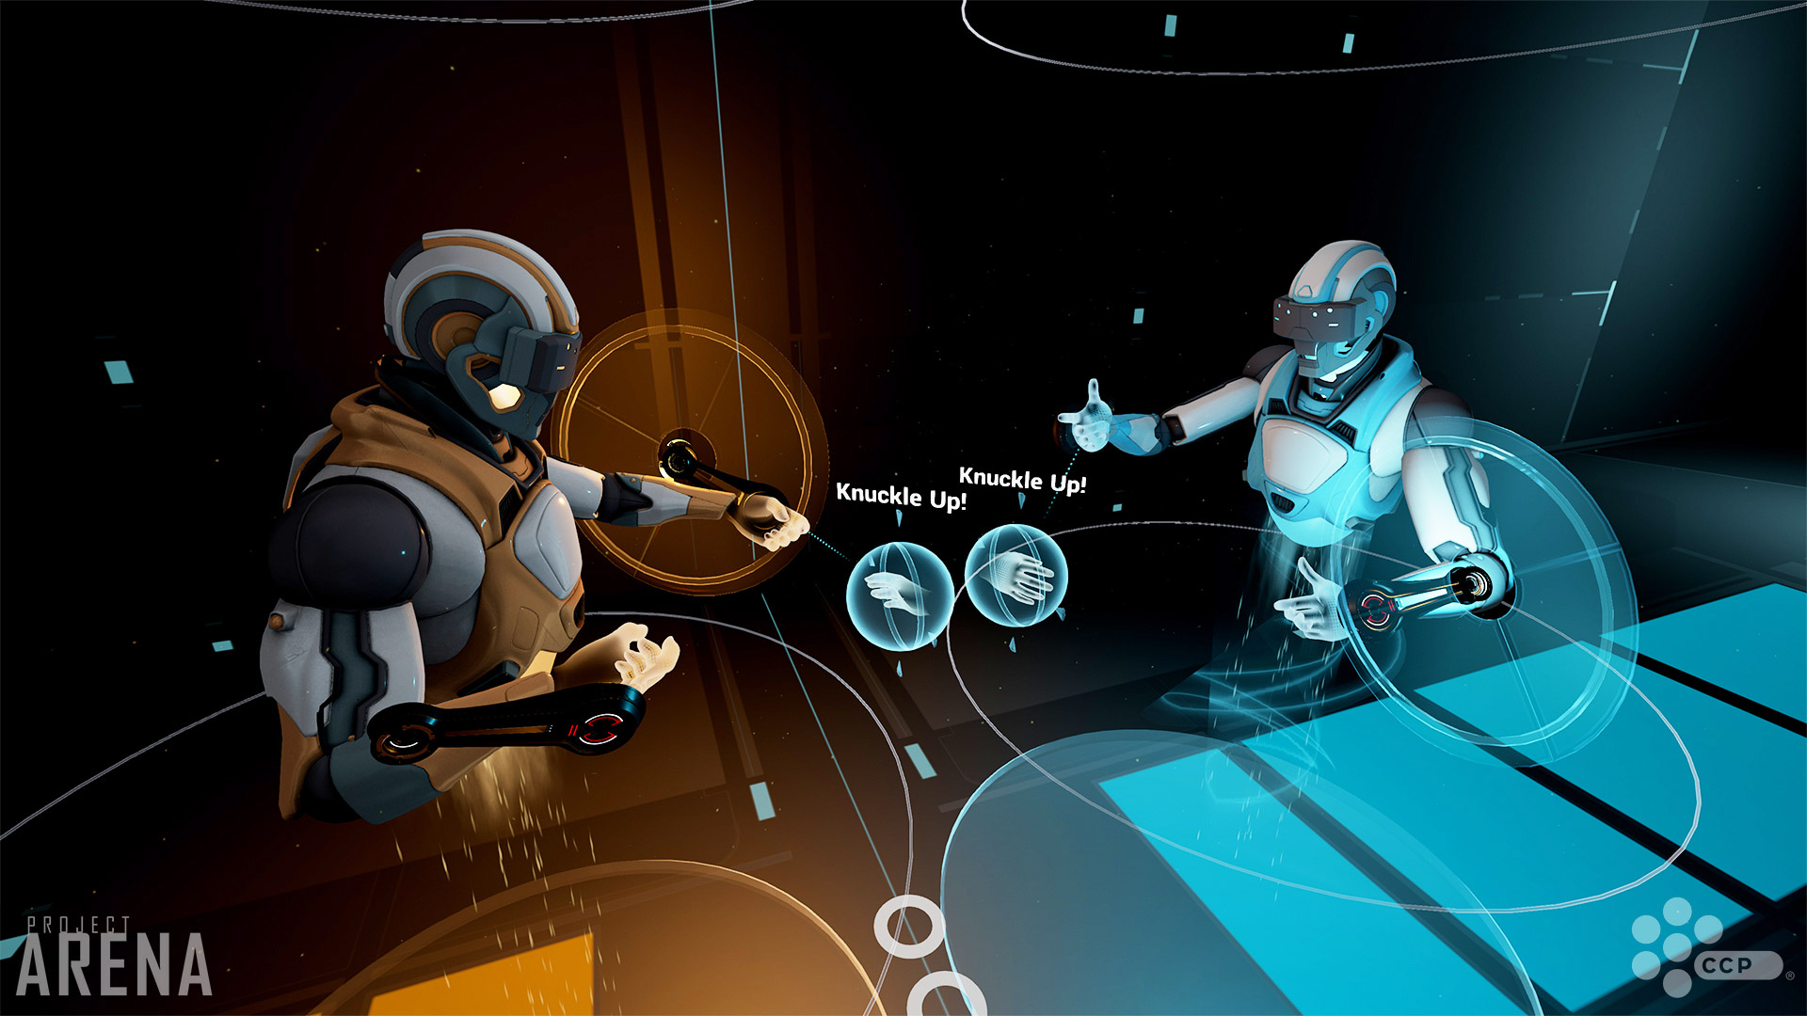
FINAL DELIVERABLES

